Slide 1






Dr. D. Y. Patil Institute of Technology, Pimpri, Pune-18
Department of Computer Engineering
Internship 2021-22
IOT based project
Name : Divyaamshu Verma
Roll No : TCOD01
Seat No : T190244266
Guide : Mr. Rajesh Bharati

Slide 2
Outline
Internship company / Course details
Internship letter/Course Syllabus
Introduction ( About the system/project)
Literature survey
Problem Statement
Objectives and scope of the system
Hardware , Software requirements
System design (System Architecture, Module diagram/UML diagrams/Algorithms)
System implementation ( Modules implemented with GUI )
Results
Conclusion
References in IEEE format
Internship diary/Course done detail schedule

Slide 3
Internship Company
Company Name: XOR Bit Infotech Pvt. Ltd.
XOR Bit Infotech is IT service providing company ,which offers cloud services , IDC consultancy , IT training , software development , Internet of things , Artificial intelligence & Machine learning services. IT follows the motto: experience exclusive excellence every time.

Slide 4
Internship Letter
I got offer letter for the Internship on 22th of December, 2021.
I applied for the internship on the LinkedIn website.
My date of joining was 1st of January.
The tenure of the internship was of one month.
I was offered the role of Trainee Engineer(IOT services).

Slide 5
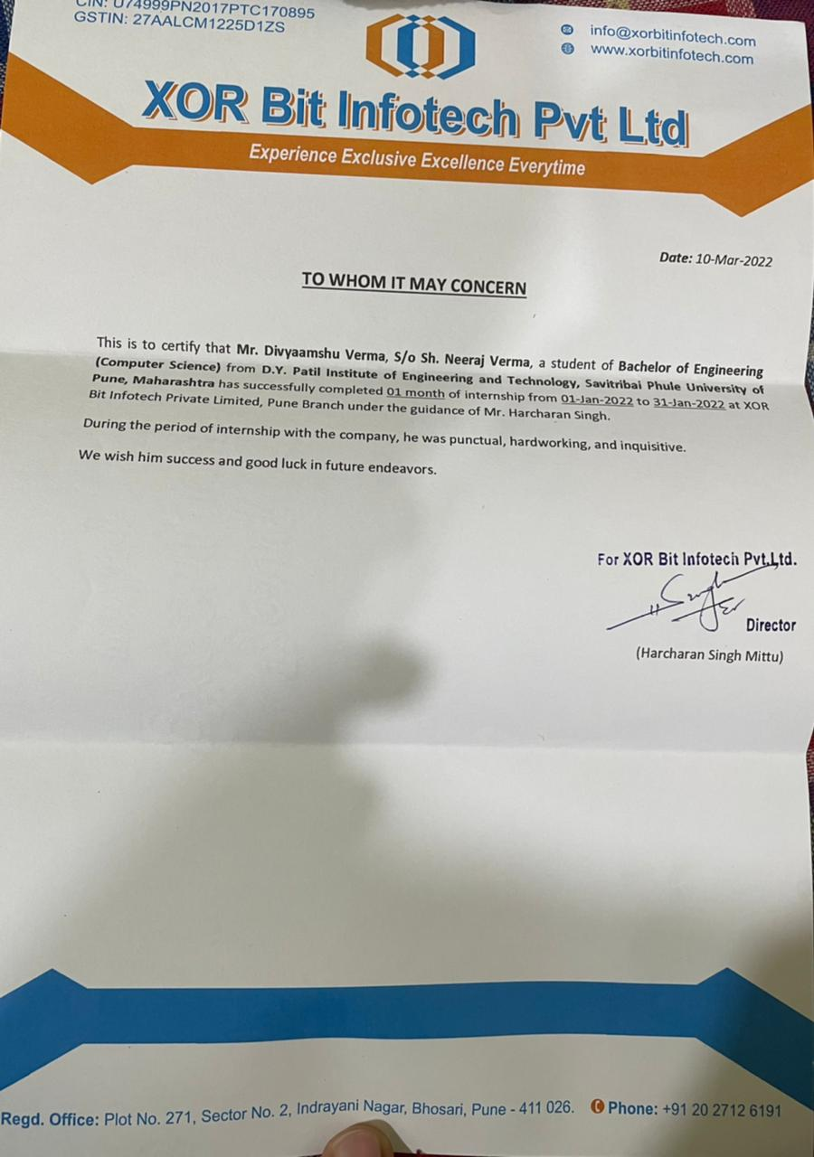
Internship Completion Certificate

Slide 6
INTRODUCTION
IOT based smart agriculture controlling system:
This project presents a new design of water pump control for the development of smart irrigation system linked with SMS.
Wastage of water in the current scenario, merely due to overflowing tanks, which is not affordable. Conventional water tanks can neither monitor nor control the water level in tank, leading to large amount of water wastage. Some other technologies had certain drawbacks in some or the other way. The need of removal of these short-comings and providing an efficient and economical solution has been the main focus of this project.
Our project is for water level monitoring as well as controlling with IOT and GSM module. The IOT platform we are using is Arduino which is an open source. An Float-level sensor is placed on the surface of the tank to sense the water level. We can monitor the tank manually using an on/off system provide to the user controlled through GSM module via text message. Index Terms: IoT, GSM module, ultrasonic sensor, Arduino.

Slide 7
Literature Survey
IOT and Neural network-based water pumping control system for smart irrigation- by M.E.Karar, M.F.Al-Rasheed and Omar Reyad.
IOT based model for monitoring and controlling water distribution- by J G Natividad and T D Palaoag.
IOT based solar water pump controller- by Mr. Gokulavasan B. , Mr. Rohith V. , Mr. Santhoss K. And Mr. Sharan R P.

Slide 8
Problem Statement
Water is always a crucial part of everyday life. Due to global environmental situation, water management and conservation is vital for human survival. In recent times, there were huge needs of consumer-based humanitarian projects that could be rapidly developed using Internet of Things (IoT) technology. Our proposed system measures water level in real-time and helps the user to monitor the water tank remotely using mobile device via text message . It helps farmers which are not present on fields to remotely check the status of their water tank and provides access to them to operate the motor pump remotely at any time.

Slide 9
Objectives
The main objective of the project was to create an IOT based system which is easy to access and operate.
To help farmers check electricity status on fields and water level in their tanks remotely
Also to provide them a way to remotely control the water pump present on their fields using their mobile phone

Slide 10
Hardware Requirements
Step Down Module (Lm2596) - is a step-down(buck) switching regulator, capable of driving a 3-A load with excellent line and load regulation. These devices are available in fixed output voltages of 3.3 V, 5 V, 12 V, and an adjustable output version.
Relay Module (5V 1Channel) - The relay module is an electrically operated switch that can be turned on or off deciding to let current flow through or not.
LCD Display and I2C Model - I2C_LCD is an easy-to-use display module; it can make display easier. Using it can reduce the difficulty of make, so that makers can focus on the core of the work.
Arduino Uno - Arduino is an open-source electronics platform based on easy-to-use hardware and software. Arduino boards are able to read inputs - light on a sensor, a finger on a button, or a Twitter message - and turn it into an output - activating a motor, turning on an LED, publishing something online.

Slide 11
GSM 800L Module - The Arduino GSM shield allows an Arduino board to connect to the internet, send and receive SMS, and make voice calls using the GSM library.
DC Pump - DC powered pumps use direct current from motor, battery, or solar power to move fluid in a variety of ways. Motorized pumps typically operate on 6, 12, 24, or 32 volts of DC power.
Float Level Sensor - Float level sensors are continuous level sensors featuring a magnetic float that rises and falls as liquid levels change. The movement of the float creates a magnetic field that actuates a hermetically sealed reed switch located in the stem of the level sensor, triggering the switch to open or close.

Slide 12

Software Requirement
GSM - This module is able to receive serial data from radiation monitoring devices such as survey meter or area monitor and transmit the data as text SMS to a host server.
Arduino Operating System – The Arduino Uno is programmed using the Arduino Software (IDE).

Slide 13
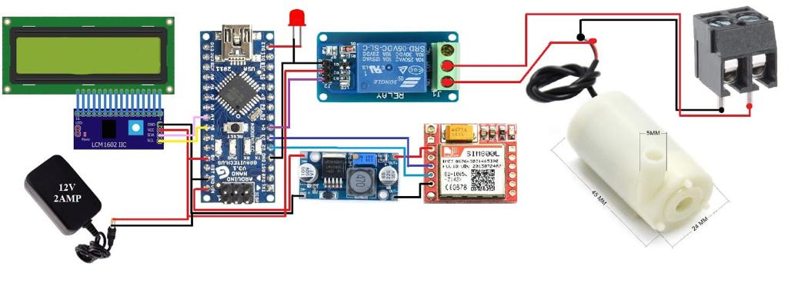
Circuit Block diagram

Slide 14
System Design
This module is composed of Float-level sensor, LCD Display, Arduino UNO micro-controller, SIM800L GSM Shield module, Step-Down Converter and 240VAC relay switch.
For monitoring, Float-level sensor was used because of its capability to probe inside water tank. The Float-level sensor is connected to the Arduino UNO micro-controller and the signal send by the sensor will be interpreted and processed by the micro-controller to evaluate the level of water in the tank. Based on the uploaded code, if the level of water requires filling the tank, then the Arduino micro-controller will send signal to turn on the solid-state relay switch where the water pump is connected. As a control measure, the same process avoid overflowing of water tank or before it gets empty. If the water is already in a full level, the Arduino micro-controller will send signal to the solid-state relay switch to turn off and when the water level is in a minimum level it will turn on. The microcontroller sends signal to the solid-state relay switch where the motorized electric valve is connected to close and open . The micro-controller will also activate the GSM module that is connected to send data to the server to report the status of the water tank and current activities of the water pump. The data will be sent through SMS which is believe as the most practical and economical way of communication. The monitoring and controlling system are also allowed to receive SMS to override the built-in automatic controlling system of this module.

Slide 15
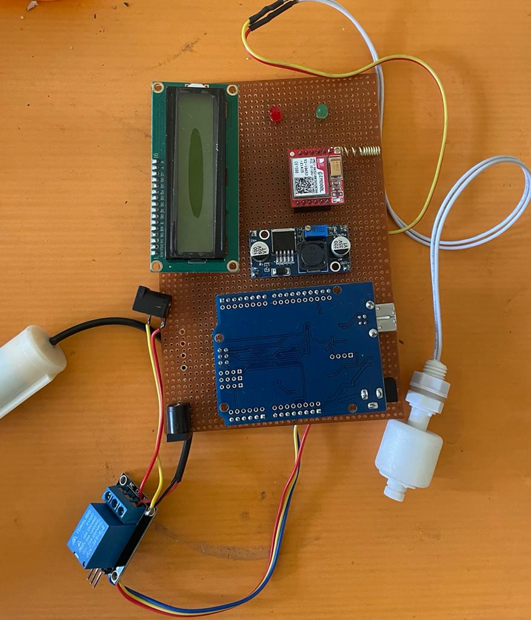
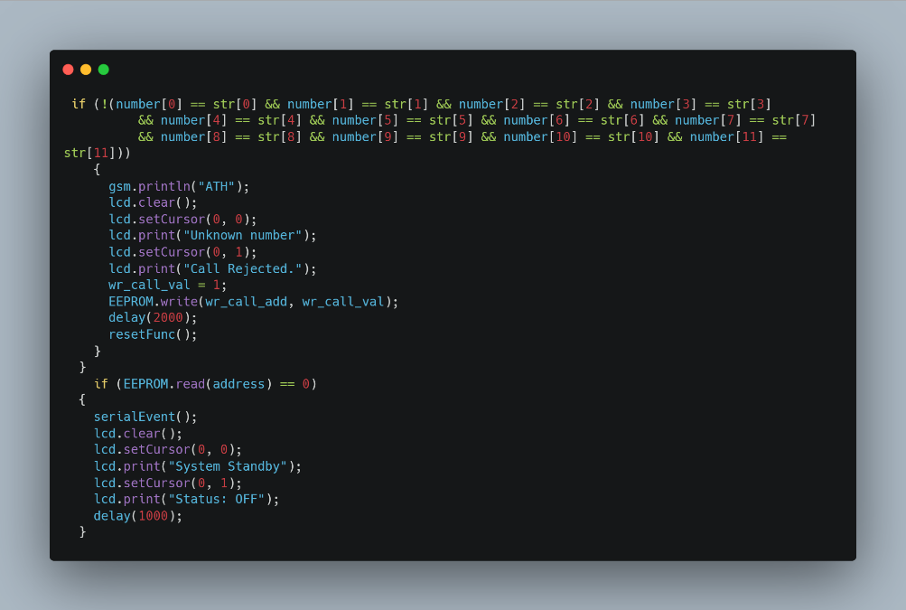
Project model
A Code Stub

Slide 16
System implementation
For this project, we have used Arduino UNO as microcontroller. The values of maximum and minimum levels are obtained by Arduino using ESP module . These values are set in the code written for Arduino UNO. The current level of water is obtained from the Float-level sensor . Depending upon these values, the motor is turned ON / OFF. Depending on the water levels the status of motor will be automatically controlled. If water level is in between both the levels, then the user can exercise control of motor using his mobile device via text message. ON and OFF have been provided for the same. The height of tank is to be set once in Arduino. This height shall be used to determine the percentage of water. Calculations of the current water level will be done with this.

Slide 17
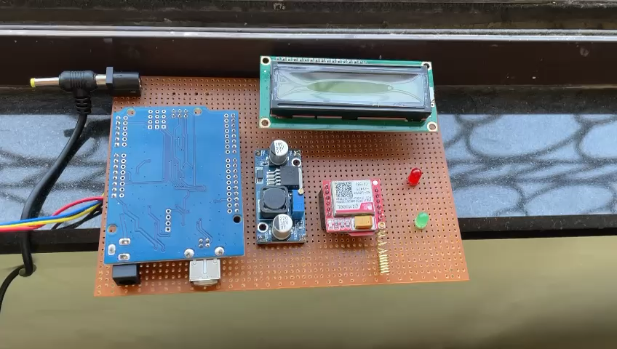
Working:

Slide 18
Algorithm
Start
Check water level in water tank
If below threshold, the water pump will start automatically and send SMS to registered mobile number
If the user wants to stop the pump, they can simply do it by sending via SMS.
If the water reaches the maximum threshold, the pump will stop automatically and send a SMS to user that the water tank is full.
Stop

Slide 19
System Features
Remote control of water pump using SMS.
Notification on SMS alerts when motor status changes.
Setup schedule for switching the pump on/off.
Module operates over GSM.
Easy to install.
Sim card insertion, on board GSM module.
Can be setup with existing pump.

Slide 20
Results
So as shown in previous slides, I have successfully finished the IOT smart irrigation system project assigned to me by made a properly working IOT model with an executable Arduino code implemented in it which checks the water level in tank and controls the motor pump via SMS through mobile phone.

Slide 21
Conclusion
So by doing this IOT based smart irrigation system project , I have successfully finished my one month internship at XOR Bit infotech Pvt. Ltd. On 31th of January.

Slide 22
References
https://www.researchgate.net/publication/341398707_IoT_and_Neural_Network- Based_Water_Pumping_Control_System_For_Smart_Irrigation
https://www.arduino.cc/en/Tutorial/HomePage
https://iopscience.iop.org/article/10.1088/1757-899X/482/1/012045
http://www.ijsred.com/volume3/issue5/IJSRED-V3I5P1.pdf
http://ieeexplore.ieee.org/document/

